Slide 1
The 3 cursors of java:

Slide 2
Cursor OF Java
If we want to get objects one by one from the collection then we should go for cursor. There are 3 types of cursors available in java. They are:
1) Enumeration
2) Iterator
3) ListIterator

Slide 3
Enumeration:
1) We can use Enumeration to get objects one by one from the legacy collection objects.
2) We can create Enumeration object by using elements() method.
Enumeration e=v.elements();
// v Vector Object

Slide 4
Enumeration interface defines the following two methods
1) public boolean hasMoreElements();
2) public Object nextElement();

Slide 5
Limitations of Enumeration:
We can apply Enumeration concept only for legacy classes and it is not a universal cursor.
By using Enumeration we can get only read access and we can’t perform remove operations.
To overcome these limitations sun people introduced Iterator concept in 1.2v.

Slide 6
Iterator:
1) We can use Iterator to get objects one by one from any collection object.
2) We can apply Iterator concept for any collection object and it is a universal cursor.
3) While iterating the objects by Iterator we can perform both read and remove operations.

Slide 7
Iterator
We can get Iterator object by using iterator() method of Collection interface. Iterator itr=c.iterator();
Iterator interface defines the following 3 methods
1)public boolean hasNext();
2)public object next();
3)public void remove();

Slide 8
Limitations of Iterator:
Both enumeration and Iterator are single direction cursors only. That is we can always move only forward direction and we can’t move to the backward direction.
2) While iterating by Iterator we can perform only read and remove operations and we can’t perform replacement and addition of new objects.
Note-To overcome these limitations sun people introduced listIterator concept.

Slide 9
ListIterator:
ListIterator is the child interface of Iterator.
By using listIterator we can move either to the forward direction (or) to the backward direction that is it is a bi-directional cursor.
While iterating by listIterator we can perform replacement and addition of new objects in addition to read and remove operations

Slide 10
ListIterator
By using listIterator method we can create listIterator object. ListIterator itr=l.listiterator();

Slide 11
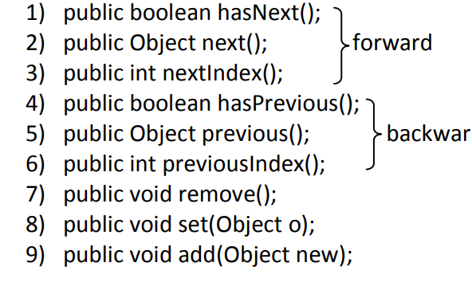
ListIterator interface defines the following 9 methods.

Slide 12
Conclusion
The most powerful cursor is listIterator but its limitation is it is applicable only for “List objects”.

Slide 13
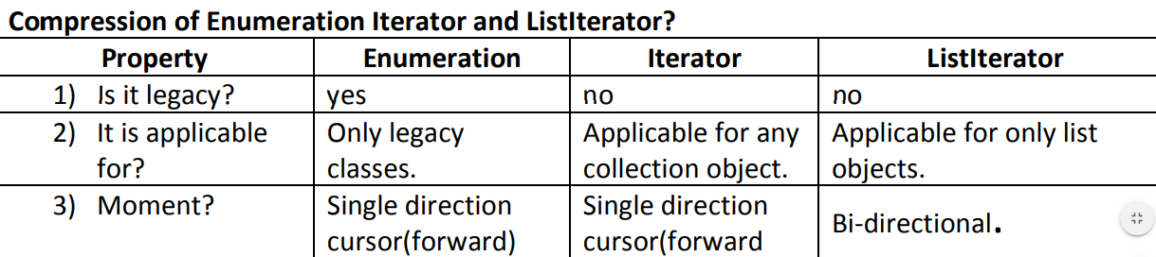

Slide 14
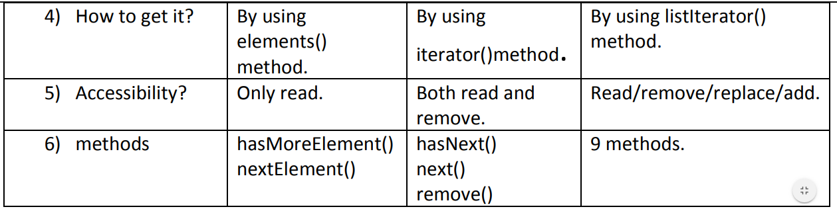

Slide 15
Set interface:
1) It is the child interface of Collection.
2) If we want to represent a group of individual objects where duplicates are not allow and insertion order is not preserved then we should go for Set interface.
3) Set interface does not contain any new method we have to use only Collection interface methods.

Slide 16
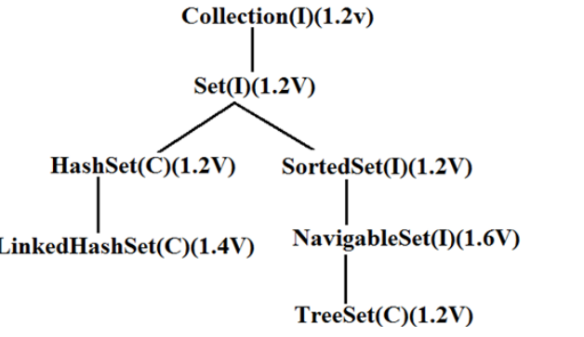
Set

Slide 17
HashSet:
The underlying data structure is Hashtable.
Insertion order is not preserved and it is based on hash code of the objects.
3) Duplicate objects are not allowed.
4) If we are trying to insert duplicate objects we won’t get compile time error and runtime error add() method simply returns false.

Slide 18
HashSet
5) Heterogeneous objects are allowed.
6) Null insertion is possible.
7) Implements Serializable and Cloneable interfaces but not RandomAccess.

Slide 19
Constructors:
1) HashSet h=new HashSet();
• Creates an empty HashSet object with default initial capacity 16 and default fill ratio 0.75(fill ratio is also known as load factor).
2) HashSet h=new HashSet(int initialcapacity);
• Creates an empty HashSet object with the specified initial capacity and default fill ratio 0.75.

Slide 20
Constructor
3) HashSet h=new HashSet(int initialcapacity,float fillratio);
4) HashSet h=new HashSet(Collection c);

Slide 21
LinkedHashSet:
It is the child class of HashSet.
2) LinkedHashSet is exactly same as HashSet except the following differences.
LinkedHashSet and LinkedHashMap commonly used for implementing “cache applications” where insertion order must be preserved and duplicates are not allowed.

Slide 22
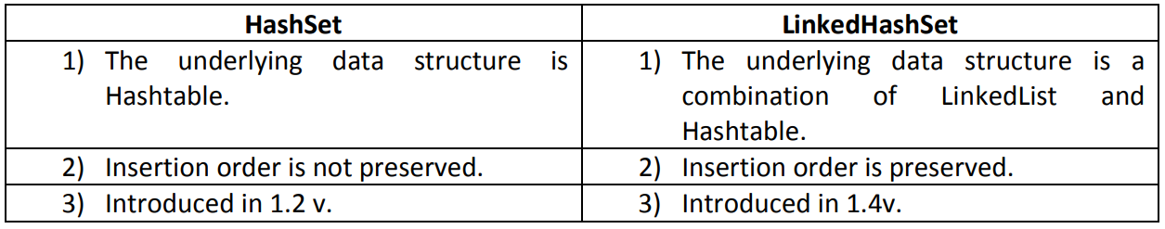
HashSet and LinkedHashet

Slide 23
SortedSet:
1) It is child interface of Set.
2) If we want to represent a group of “unique objects” according to some sorting order then we should go for SortedSet interface.
3) That sorting order can be either default natural sorting (or) customized sorting order.

Slide 24
SortedSet 6 specific methods.
1)Object first();
2) Object last();
3) SortedSet headSet(Object o);
• Returns the SortedSet whose elements are <o.
4) SortedSet tailSet(Object o);
It returns the SortedSet whose elements are >=o.

Slide 25
SortedSet
5) SortedSet subset(Object o1,Object o2);
Returns the SortedSet whose elements are >=o1but <o2.
6) Comparator comparator();
• Returns the Comparator object that describes underlying sorting technique.
• If we are following default natural sorting order then this method returns null.

Slide 26
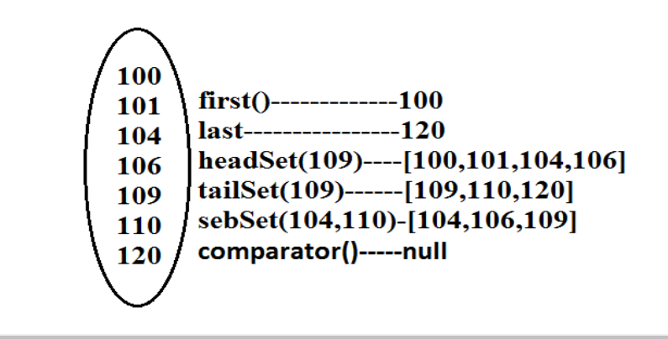
SortedSet

Slide 27
TreeSet:
The underlying data structure is balanced tree.
Duplicate objects are not allowed.
Insertion order is not preserved and it is based on some sorting order of objects
Heterogeneous objects are not allowed if we are trying to insert heterogeneous objects then we will get ClassCastException

Slide 28
Constructors:
1) TreeSet t=new TreeSet();
• Creates an empty TreeSet object where all elements will be inserted according to default natural sorting order.
2) TreeSet t=new TreeSet(Comparator c);
• Creates an empty TreeSet object where all objects will be inserted according to customized sorting order specified by Comparator object.

Slide 29
Constructor
3) TreeSet t=new TreeSet(SortedSet s);
4) TreeSet t=new TreeSet(Collection c);

Slide 30
Example
TreeSet t=new TreeSet();
t.add(new StringBuffer("A"));
t.add(new StringBuffer("Z"));
t.add(new StringBuffer("L"));
t.add(new StringBuffer("B"));
System.out.println(t);

Slide 31
Runtime Exception.
• Exception in thread "main" java.lang.ClassCastException: java.lang.StringBuffer cannot be cast to java.lang.Comparable
• If we are depending on default natural sorting order compulsory the objects should be homogeneous and Comparable otherwise we will get ClassCastException.

Slide 32
• An object is said to be Comparable if and only if the corresponding class implements Comparable interface.
• String class and all wrapper classes implements Comparable interface but StringBuffer class doesn’t implement Comparable interface hence in the above program we are getting ClassCastException.

